Slide 1
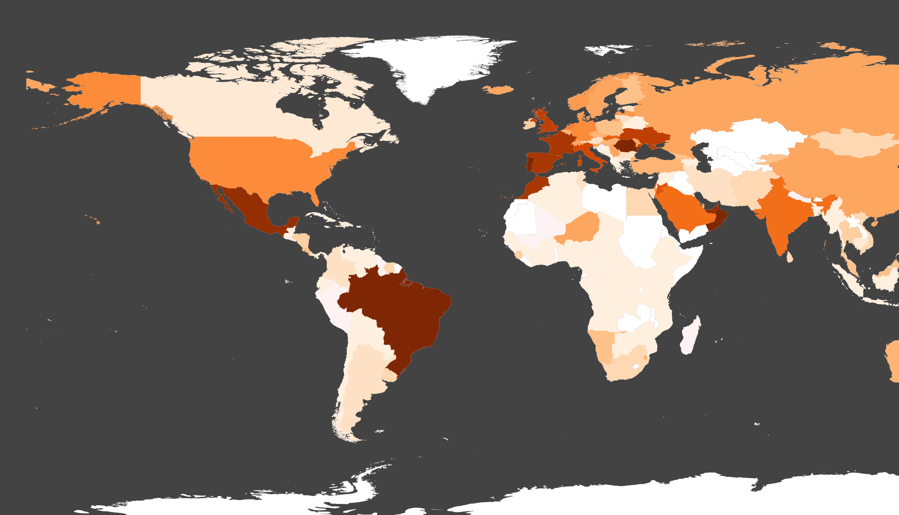


Teleconnections
and spatial metabolic rifts
in urban material circularity
Thomas Elliot thomas.elliot@etsmtl.ca
Postdoctoral Fellow, ÉTS

Slide 2
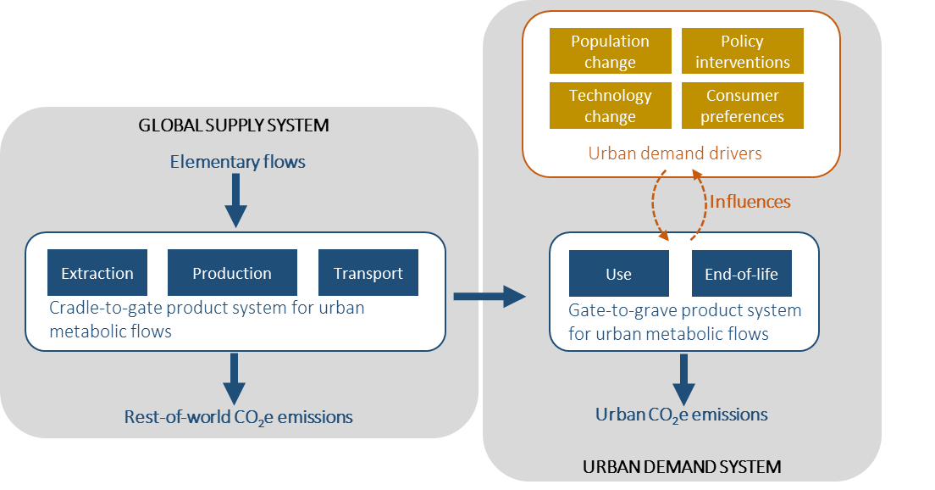
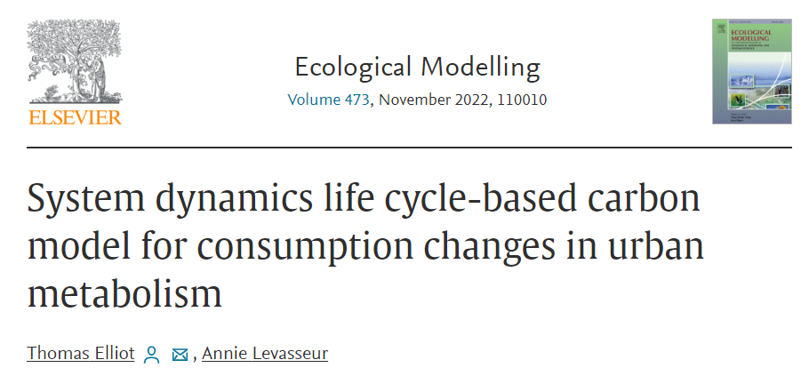
Elliot & Levasseur (2022). System dynamics life cycle-based carbon model for consumption changes in urban metabolism. Ecological Modelling

Slide 3
Urban metabolism
Life-cycle thinking
System dynamics
Elliot & Levasseur (2022). System dynamics life cycle-based carbon model for consumption changes in urban metabolism. Ecological Modelling

Slide 4
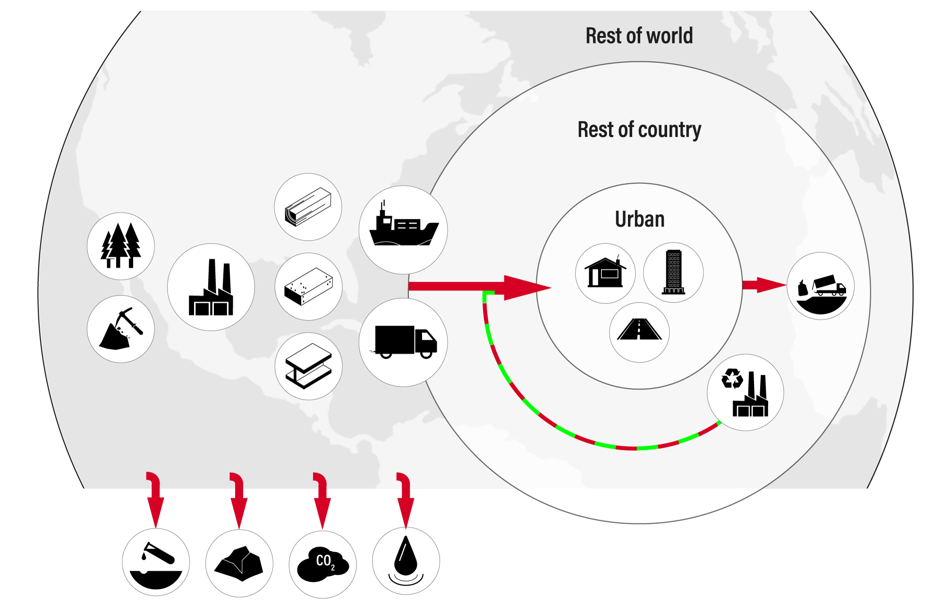
Elliot, Vigier, & Levasseur (fc). Teleconnections and spatial metabolic rifts in urban material circularity

Slide 5
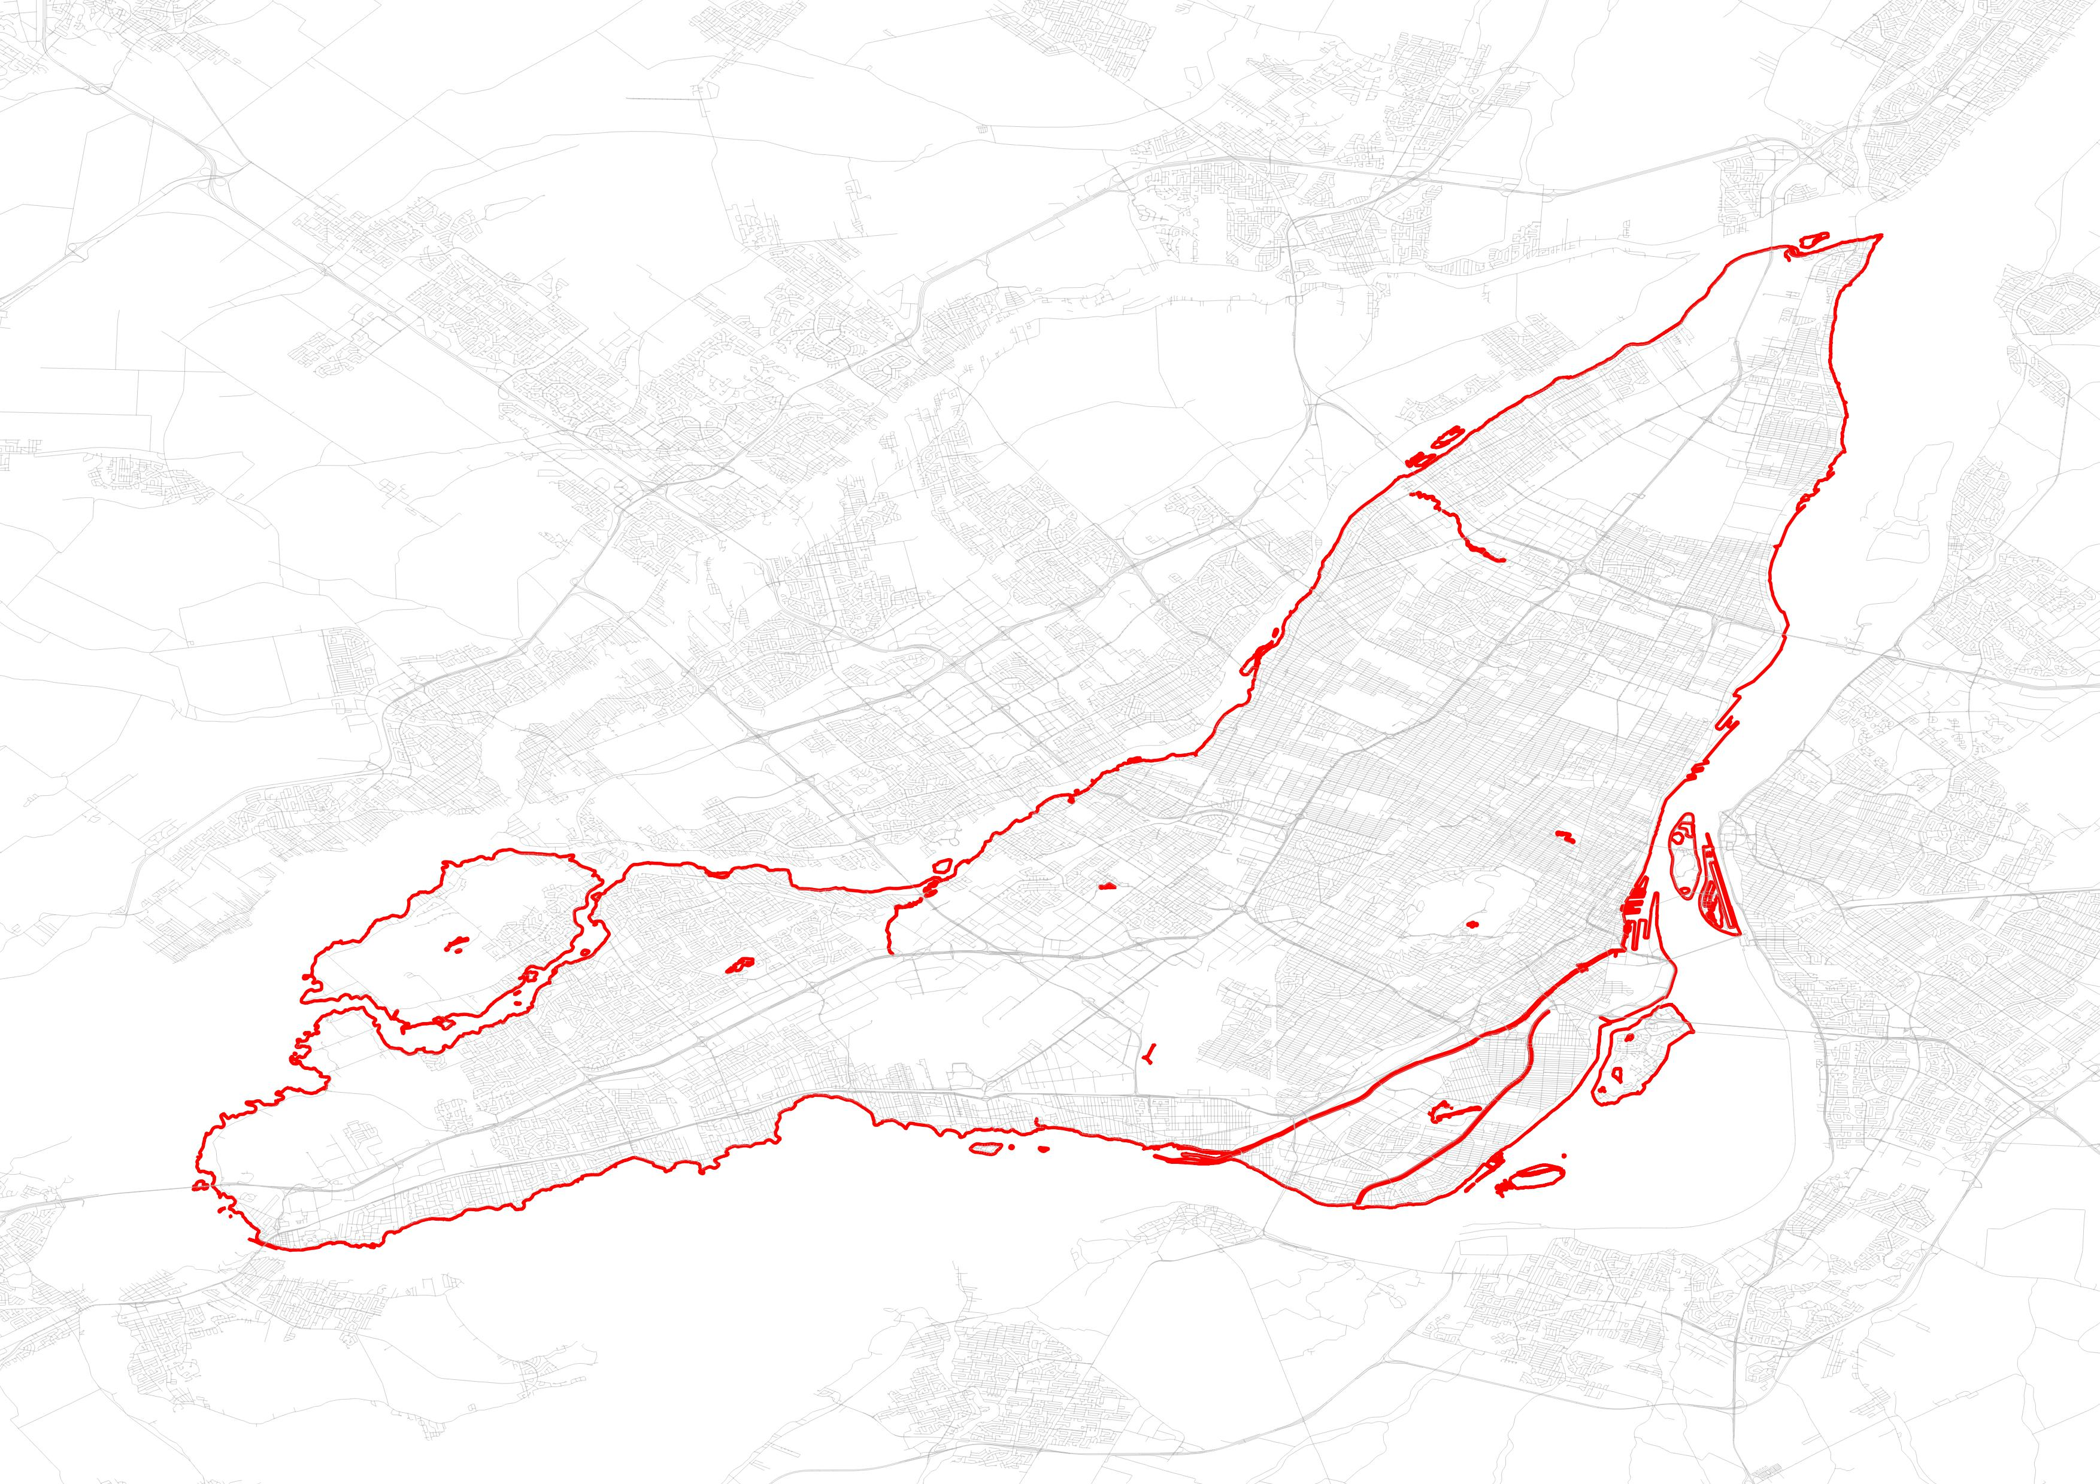
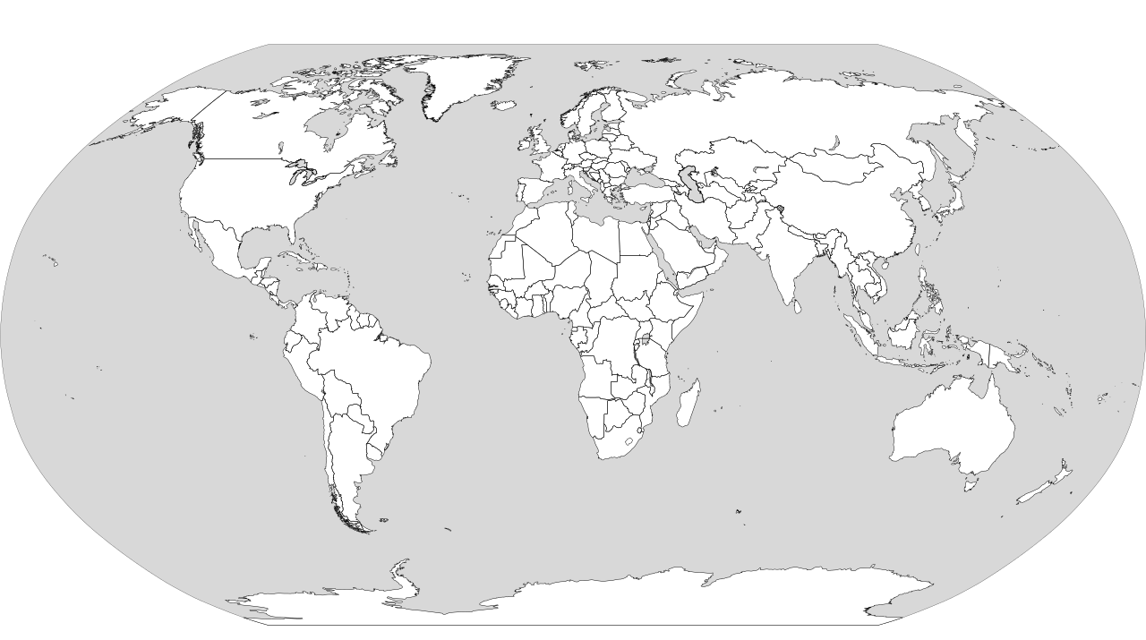
Montreal agglomeration, Quebec, Canada
Notes:
Map of Montreal

Slide 6

Rest of Canada
Rest of Quebec
Montreal
Rest of world

Slide 7



Material circularity indicator
$$MCI=1−\left(\frac{V+W}{2M}\right)∙\frac{0.9}{X}$$
$$M Material \\ V Virgin material \\ W Waste material \\ X utility of material, normally=1$$
$$Optimal MCI=1−\left(\frac{V_{min}+W_{min}}{2M}\right)∙\frac{0.9}{X_{max}}$$
Ellen MacArthur Foundation and ANSYS Granta. (2019). Circularity Indicators: An Approach to Measuring Circularity.

Slide 8
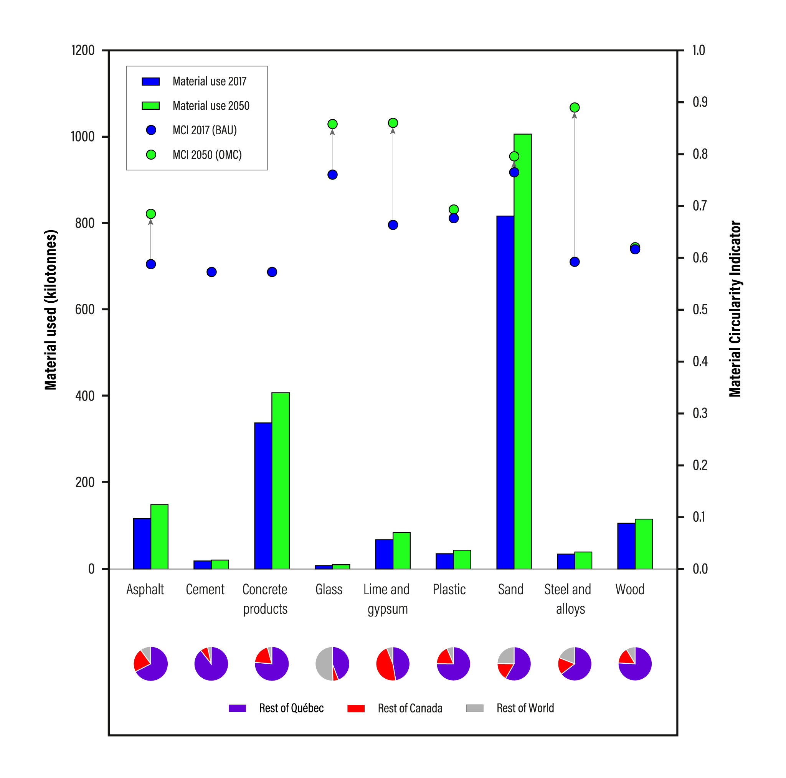
Elliot, Vigier, & Levasseur (fc). Teleconnections and spatial metabolic rifts in urban material circularity

Slide 9
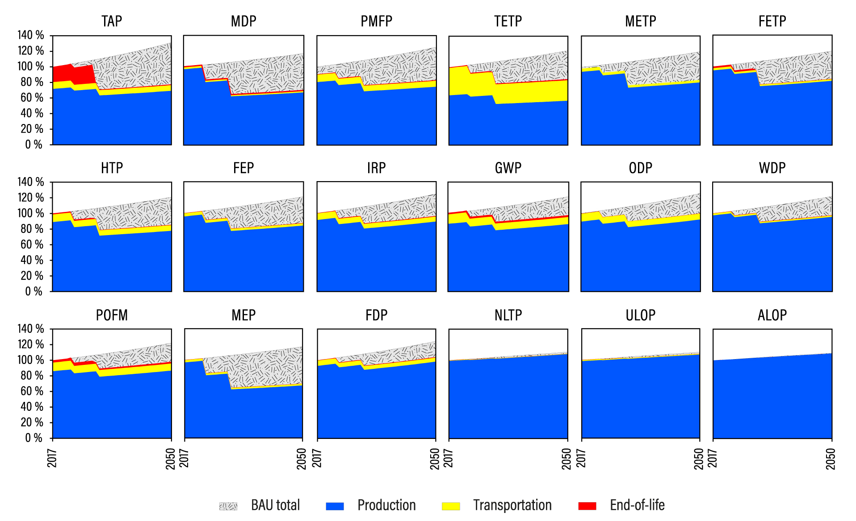
Impact changes to 2050
Elliot, Vigier, & Levasseur (fc). Teleconnections and spatial metabolic rifts in urban material circularity

Slide 10
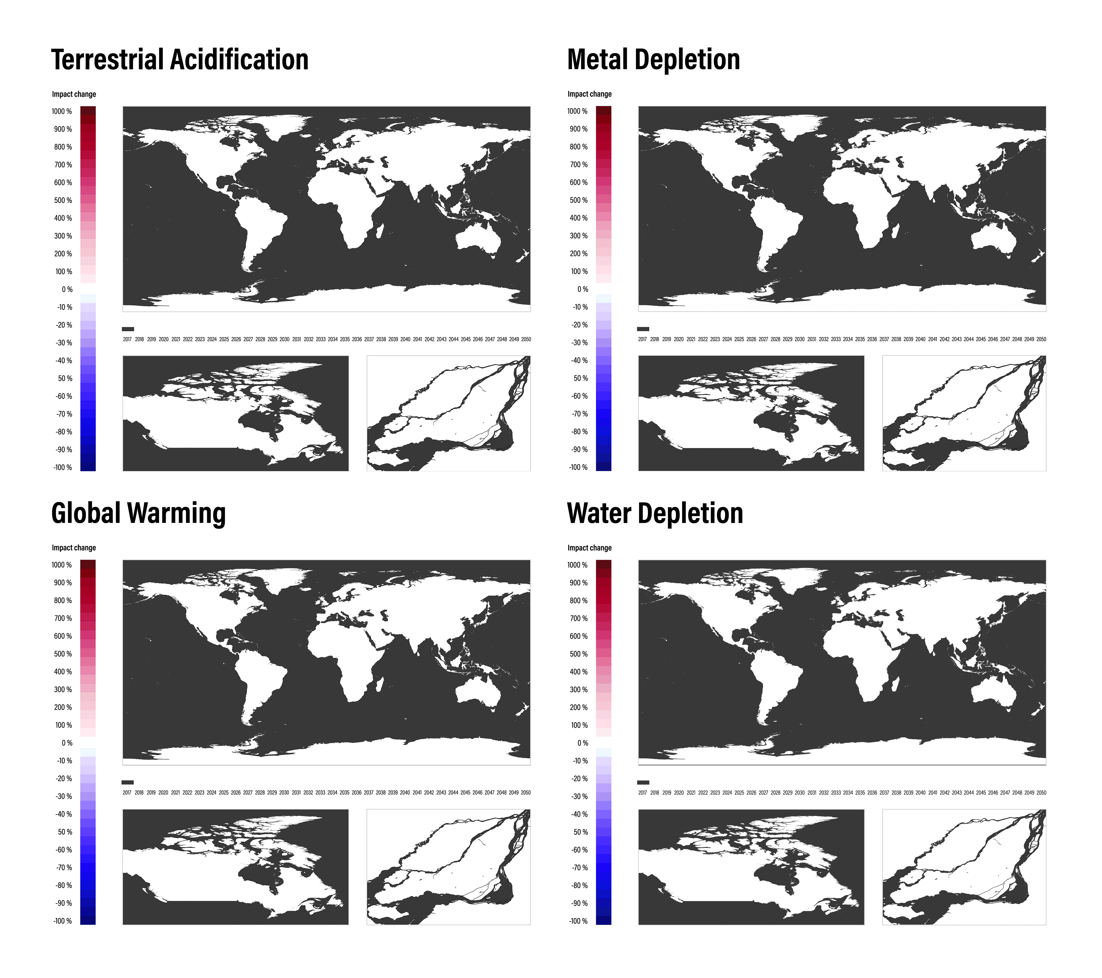
Elliot, Vigier, & Levasseur (fc). Teleconnections and spatial metabolic rifts in urban material circularity

Slide 11
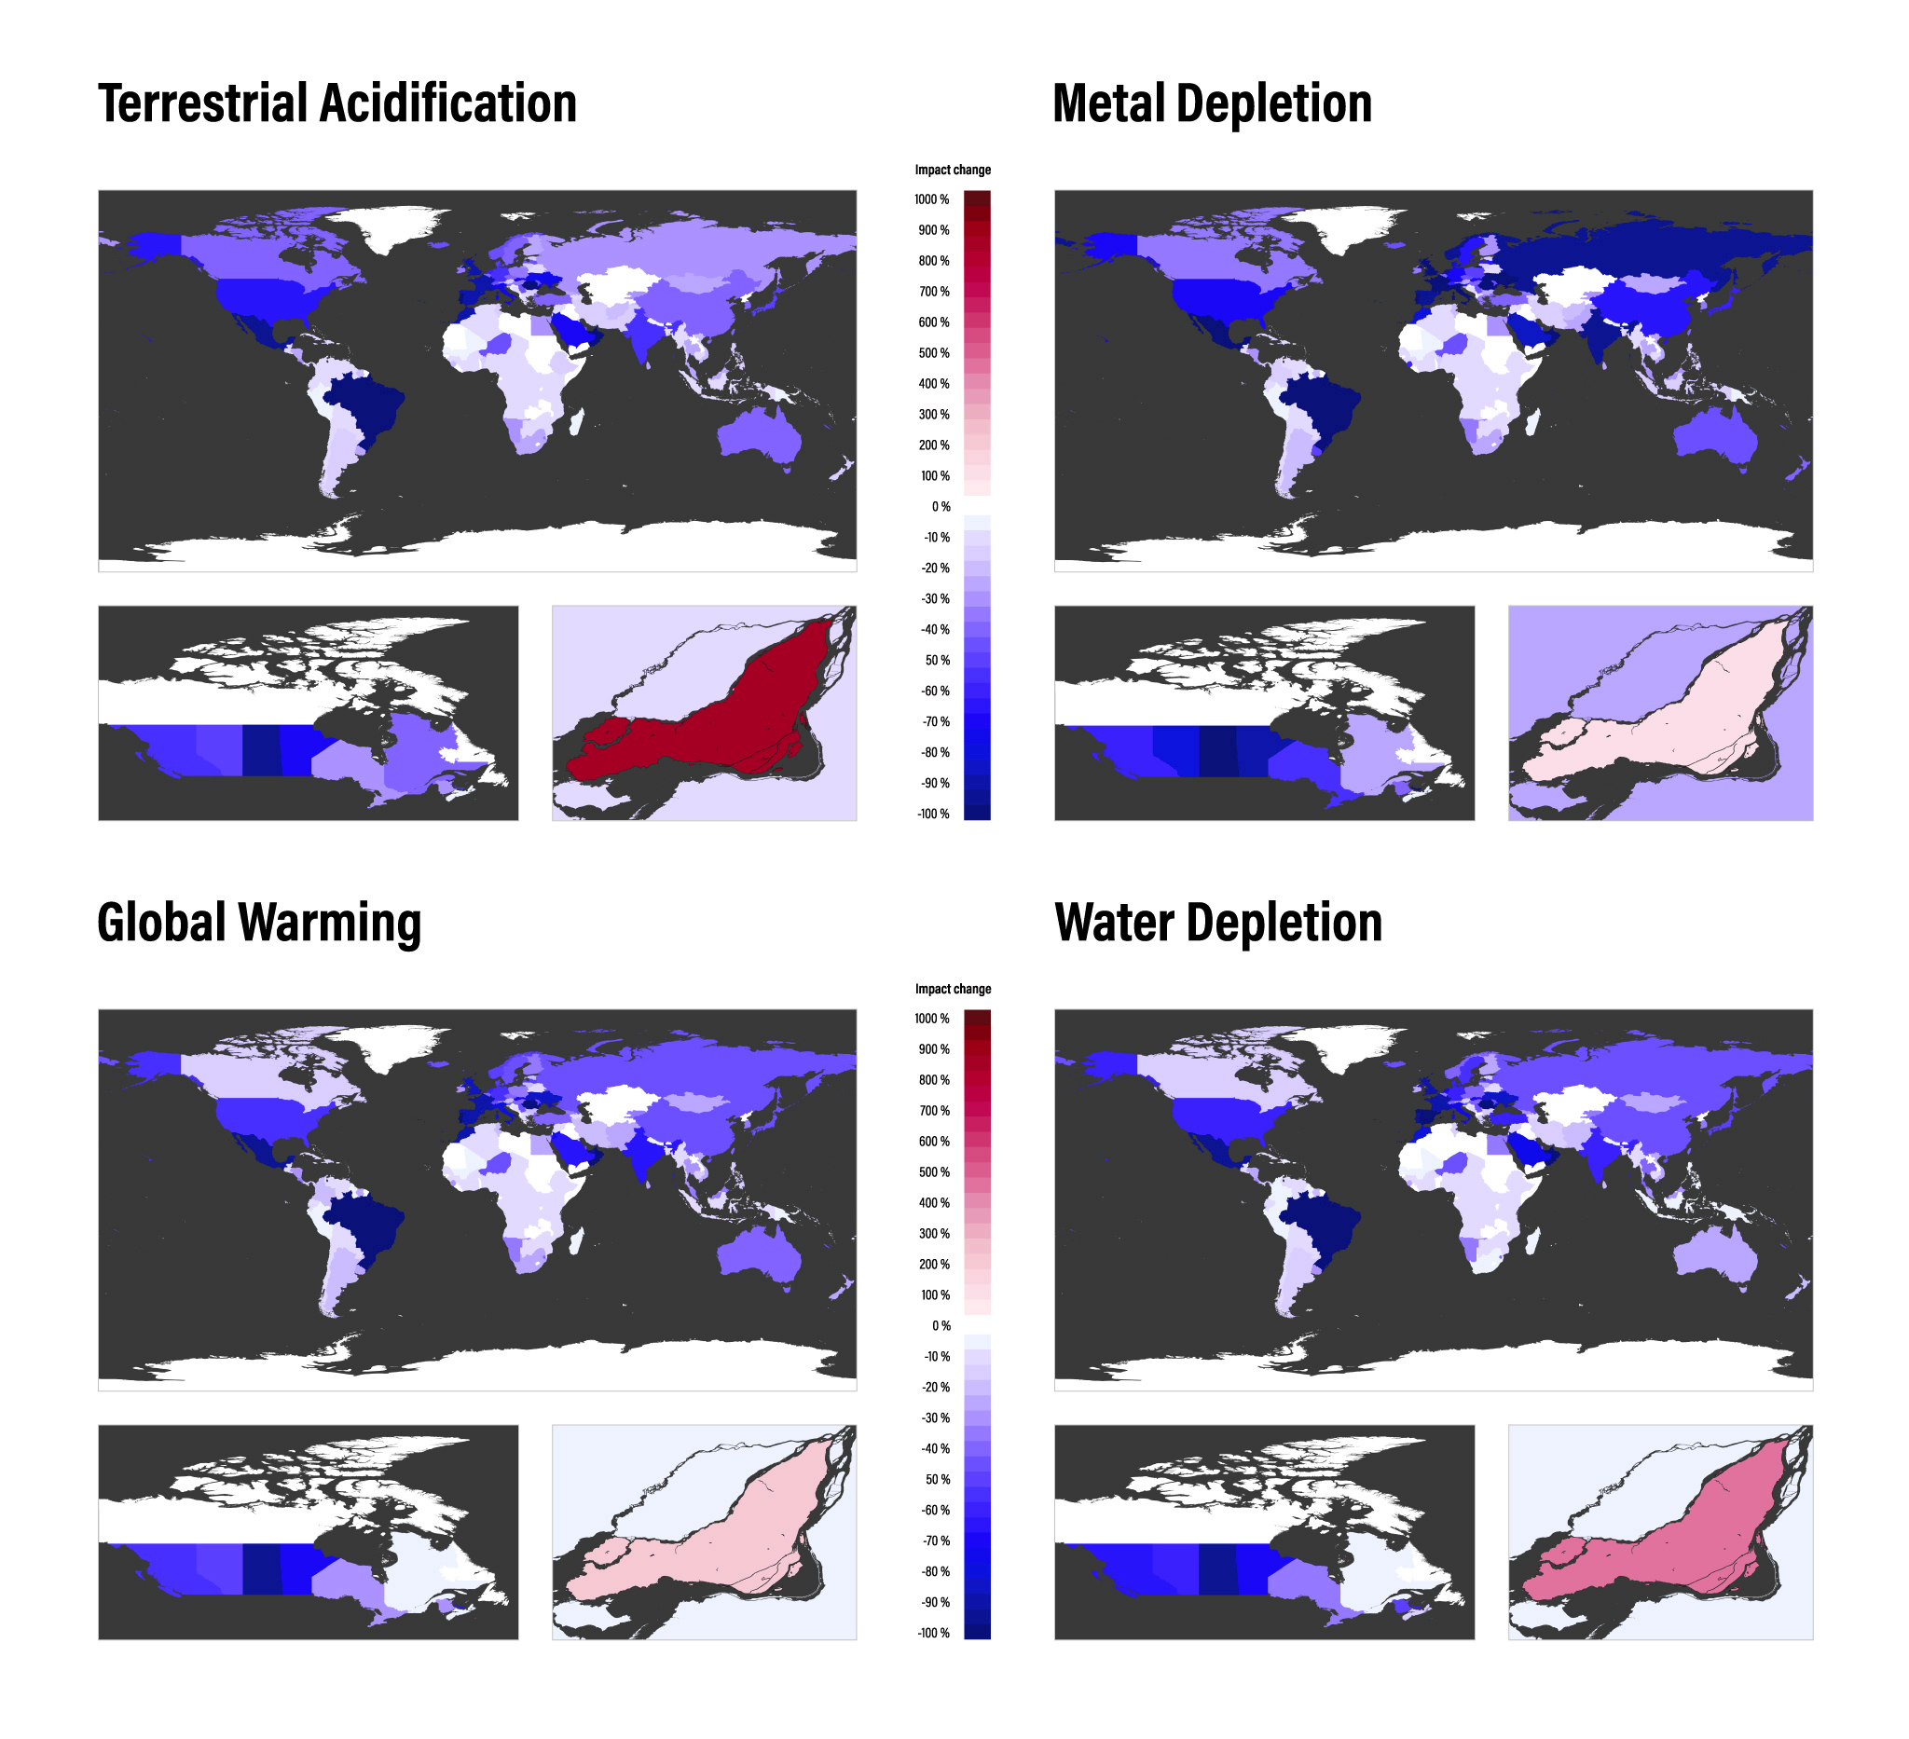
Impact changes by 2050
Elliot, Vigier, & Levasseur (fc). Teleconnections and spatial metabolic rifts in urban material circularity

Slide 12
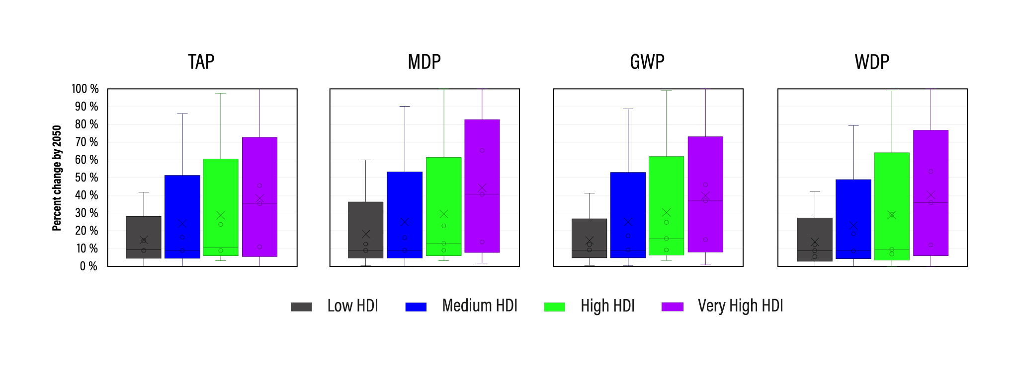
Who benefits from impact reduction?
Elliot, Vigier, & Levasseur (fc). Teleconnections and spatial metabolic rifts in urban material circularity

Slide 13
Burden shifting occurs across spatial levels
Trade-offs are small and synergies are large
Material circularity alone is insufficient
Degrowth could complement the circular transition
Elliot, Vigier, & Levasseur (fc). Teleconnections and spatial metabolic rifts in urban material circularity

Slide 14
Teleconnections
and spatial metabolic rifts
in urban material circularity
Thomas Elliot thomas.elliot@etsmtl.ca
Postdoctoral Fellow, ÉTS

